Slide 1
The Pilgrim Church
Kingdom churches throughout the centuries.

Slide 2
ROGER BANNISTER
Roger Bannister

Slide 3
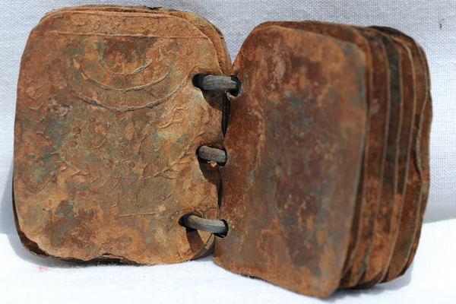
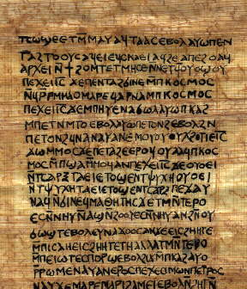
Literature

Slide 4
Reading in the proper order
“They disregard the order and the connection of scriptures… just as if one, when a beautiful image of a king has been constructed out of precious jewels, should this take the likeness of the man all to pieces, should re-arrange the gems, and so fit them together as to make them into the form of a dog or of a fox… and should then maintain and declare that this was the beautiful image of the king.” (Irenaeus, Against Heresies 1.8.1)

Slide 5
The Two Ways Didache
“There are two ways, one of life and one of death; but a great difference between the two ways. The way of life, then, is this: First, you shall love God who made you; second, your neighbor as yourself; and all things whatsoever you would should not occur to you, do not also do to another. And of these sayings the teaching is this: Bless those who curse you, and pray for your enemies,…”

Slide 6
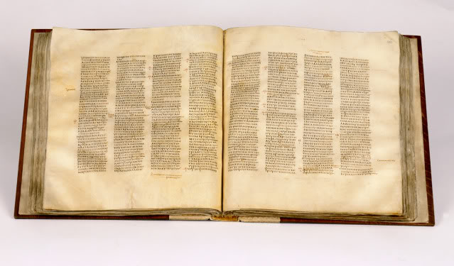
The Epistle of Barnabas
“But let us pass on to another lesson and teaching. There are two ways of teaching and of power, the one of light and the other of darkness; and there is a great difference between the two ways. For on the one are stationed the light giving angels of God, on the other the angels of Satan.”

Slide 7
The way
Follow
Jesus
For we forewarn you to be on your guard, lest those demons whom we have been accusing should deceive you, and quite divert you from reading and understanding what we say. For they strive to hold you their slaves and servants; and sometimes by appearances in dreams, and sometimes by magical impositions, they subdue all who make no strong opposing effort for their own salvation. And thus do we also, since our persuasion by the Word, stand aloof from them (i.e., the demons), and follow the only unbegotten God through His Son —
We who formerly delighted in fornication, but now embrace chastity alone; we who formerly used magical arts, dedicate ourselves to the good and unbegotten God; we who valued above all things the acquisition of wealth and possessions, now bring what we have into a common stock, and communicate to every one in need;

Slide 8
Him or It?
Men were made like God, free from suffering and death, provided that they keep his commandments, and were deemed deserving of the name of His sons, and yet they, becoming like Adam and Eve, work out death for themselves; let the interpretation of the Psalms be held just as you wish, yet thereby it is demonstrated that all men are deemed worthy of becoming “gods,” and of having power to become sons of the highest,. Justin
“The Lord took upon Himself what is ours and, by offering it in sacrifice, destroyed it, and clothed us in what is His.’ Athanasius.
“In what way will man pass over into God if God has not passed over into man? For in no way could we receive incorruptibility and immortality if we were not united with incorruptibility and immortality.” Irenaeus

Slide 9
Racism and bigotry
“We who hated and destroyed one another, and on account of their different manners would not live with men of a different tribe, now, since the coming of Christ, live familiarly with them, and pray for our enemies, and endeavor to persuade those who hate us unjustly to live conformably to the good precepts of Christ, to the end that they may become partakers with us of the same joyful hope of a reward from God the ruler of all.
But lest we should seem to be reasoning philosophically, we consider it right, before giving you the promised explanation, to cite a few precepts given by Christ Himself. And be it yours, as powerful rulers, to inquire whether we have been taught and do teach these things truly. Brief and concise utterances fell from Him, for He was no sophist, but His word was the power of God.”

Slide 10
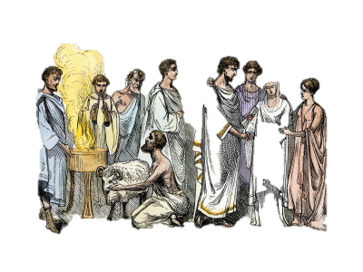
Marriage is Permanent
Concerning chastity, He uttered such sentiments as these: Whosoever looks upon a woman to lust after her, has committed adultery with her already in his heart before God. And, If your right eye offend you, cut it out; for it is better for you to enter into the kingdom of heaven with one eye, than, having two eyes, to be cast into everlasting fire. And, Whosoever shall marry her that is divorced from another husband, commits adultery. …So that all who, by human law, are twice married, are in the eye of our Master-- sinners, and those who look upon a woman to lust after her. For not only he who in act commits adultery is rejected by Him, but also he who desires to commit adultery: since not only our works, but also our thoughts, are open before God. ..; And of our love to all, He taught thus: If you love them that love you….. (Vol 1 pg 166-167)

Slide 11
In the early Church, how did the faith affect every day life?
“Do we have to ask the pagans themselves about this? Let them tell us whether it is right for Christians to attend the shows? Why, the rejection of these amusements is the primary sign to them that a man has adopted the Christian Faith.”
“The father who carefully protects and guards his virgin daughter’s ears from every polluting word takes her to the theater himself, exposing her to all its vile language and attitudes.” How can it be right to look at the things that are wrong to do? How can those things which defile a man when they go out of his mouth not defile him when going in through his eyes and ears?”
Entertainment

Slide 12
War
Men of old were used to requiring "eye for eye, and tooth for tooth" and to repay evil for evil, with usury! ... But after Christ has supervened and has united the grace of faith with patience, now it is no longer lawful to attack others even with words, nor to merely say "fool," without danger of the judgment. ...Christ says, "Love your enemies and bless your curses, and pray for your persecutors." -Tertullian (c. 200, W,) 3.711
For what difference is there between provoker and provoked? The only difference is that the former was the first to do evil, but the latter did evil afterwards. Each one stands condemned in the eyes of the Lord for hurting a man. For God both prohibits and condemns every wickedness. In evil doing, there is no account taken of the order. ... The commandment is absolute: evil is not to be repaid with evil. -Tertullian (c. 200, W), 3.713
Clement of Alexandria wrote in 217 A.D.: “He who holds the sword must cast it away and that if one of the faithful becomes a soldier, he must be rejected by the Church, for he has scorned God.”“For even if soldiers came to John and received advice on how to act, and even if a centurion became a believer, the Lord, in subsequently disarming Peter, disarmed every soldier” (Treatise on Idolatry 19; Ante-nicene Fathers3:73).

Slide 13
Unlawful Professions
…A military man in authority must not execute men. If he is ordered, he must not carry it out. Nor must he take military oath. If he refuses, he shall be rejected. If someone is a military governor, a or the ruler of a city who wears the purple, he shall cease or he shall be rejected. The catechumen or faithful who wants to become a soldier is to be rejected, for he has despised God. (Apostolic Constitution of Hippolytus)

Slide 14
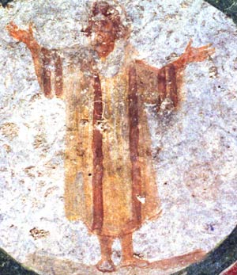
Modesty
For these worthless and see- through materials are the proof of a weak mind, covering as they do the shame of the body with a slender veil. For luxurious clothing, which cannot conceal the shape of the body, is no more a covering. For such clothing, falling close to the body, takes its form more easily, and adhering as it were to the flesh, receives its shape, and marks out the woman's figure, so that the whole make of the body is visible to spectators, though not seeing the body itself. (Clement of Alexandria (A.D. 195) Ante-Nicene Fathers vol.2 pg.265

Slide 15
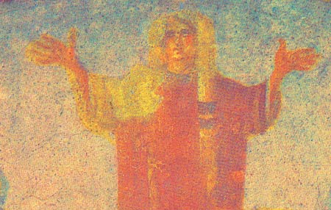
Modesty
“Let women,” said he, “adorn themselves with shamefacednes and sobriety, not with broidered hair, nor gold, nor pearls, nor costly array, but as becomes women professing chastity, with a good conversation.” Also Peter consents to these same precepts, and says, “Let there be in the woman not the outward adorning of array, or gold, or apparel, but the adorning of the heart.”
….you cannot be excused on the pretense that you are chaste and modest in mind. Your shameful dress and immodest ornament accuse you; nor can you be counted now among Christ’s maidens and virgins, since you live in such a manner as to make yourselves objects of desire. Cyprian (A.D. 250) Ante-Nicene Fathers vol.5 pg.432)

Slide 16
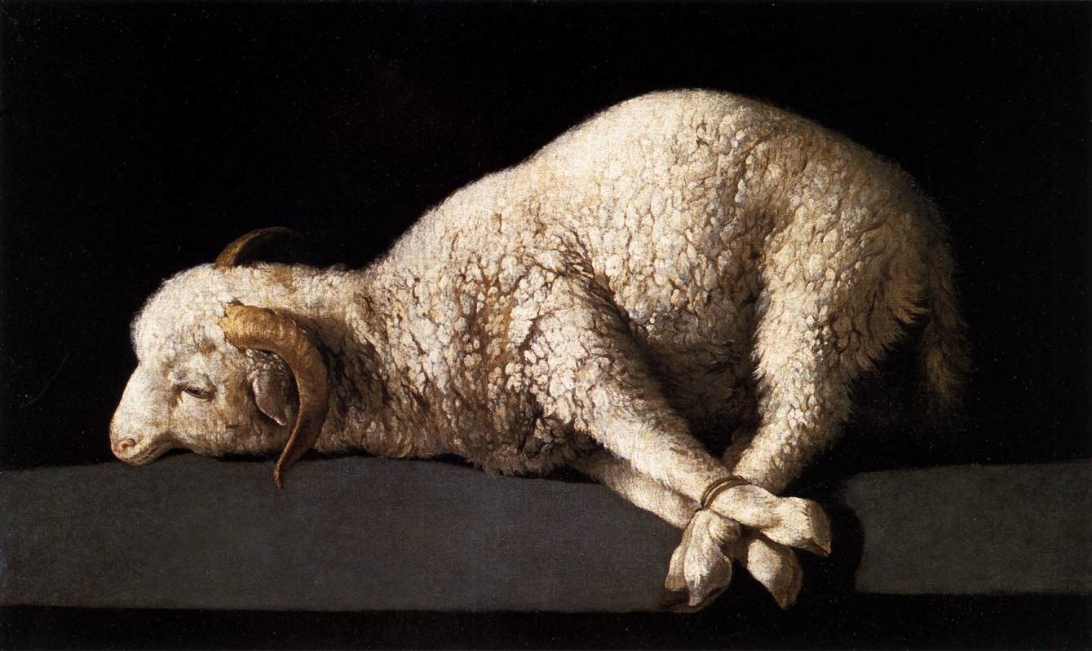
Theology of Martyrdom
”It's a beautiful thing to God when a Christian does battle with pain. When he faces threats, punishments and tortures by mocking death and treading underfoot the horror of the executioner; when he raises up his freedom in Christ as a standard before kings and princes; when he yields to God alone, and—triumphant and victorious—he tramples upon the very man who has pronounced the sentence upon him … God finds all these things beautiful.” (The Octavius 37)

Slide 17
Sharing Life!
“You shall communicate in all things with your neighbor; you shall not call things your own; for if you are partakers in common of things which are incorruptible, how much more [should you be] of those things which are corruptible!” Barnabas (A.D. 70-130) ch.19
“Do not turn away from him who is in want; rather, share all things with your brother, and do not say that they are your own. For if you are partakers in that which is immortal, how much more in things which are mortal?” Didache (A.D. 80-140) ch.4

Slide 18
“Toil together one with another, struggle together, run together, suffer together, lie down together, rise up together, as God's stewards and assessors and ministers.” Ignatius: to Polycarp (A.D. 35-105) ch.6
“They have their meals in common, but not their wives.”
Letter to Diognetus (A.D. 125-200) ch.5

Slide 19
A Disciplined Church
“You say that we are a most shameful throng and that we are utterly steeped in Luxury, wickedness, and depravity. We will not deny that this is true of some who profess to be Christians. Even the healthiest and purest body usually has a mole, a wart, or freckles on it. Even the sky itself is not perfectly clear so as not to be flecked with some wispy cloud. However, any person who conduct themselves in th way you have described do not assemble with us. Neither do they belong to our communion. By their delinquency, they become yours once more. You have no right to call those Christians to whom we Christians ourselves deny that name.” (Tertullian)

Slide 20
Gnostic
Is there some comparison of Gnosticism to Modern American Evangelicalism?
Christianity isn’t a Religion or a way of life-- it’s a secret Relationship.
Salvation Means Going to Heaven When You Die
The Material World isn’t Important
Organized Religion is Bad
Jesus’ Kingdom has no use for this World
Knowledge saves
God Doesn’t Work Through physical things
“Beloved, believe not every spirit, but try the spirits whether they are of God: because many false prophets are gone out into the world. Hereby know ye the Spirit of God: Every spirit that confesseth that Jesus Christ is come in the flesh is of God: And every spirit that confesseth not that Jesus Christ is come in the flesh is not of God: and this is that spirit of antichrist, whereof ye have heard that it should come; and even now already is it in the world.” (1John 4:1-3)

Slide 21
Diocletian
Final empire-wide persecution in the early Church.

Slide 22
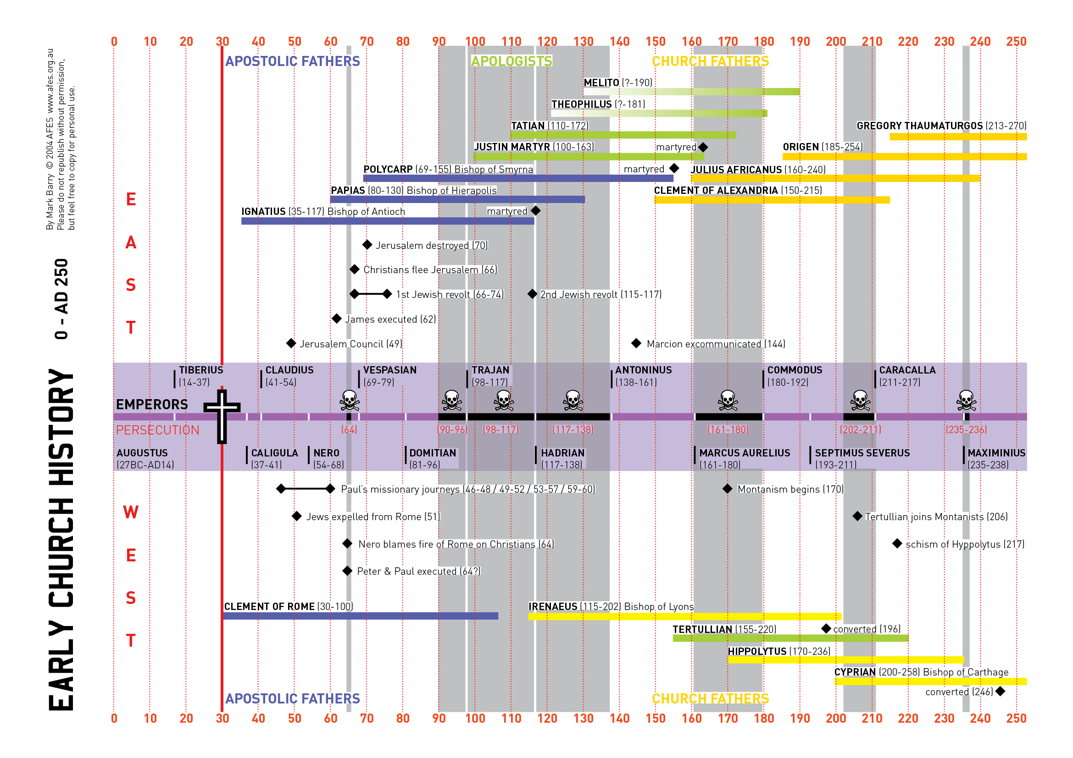

Slide 23
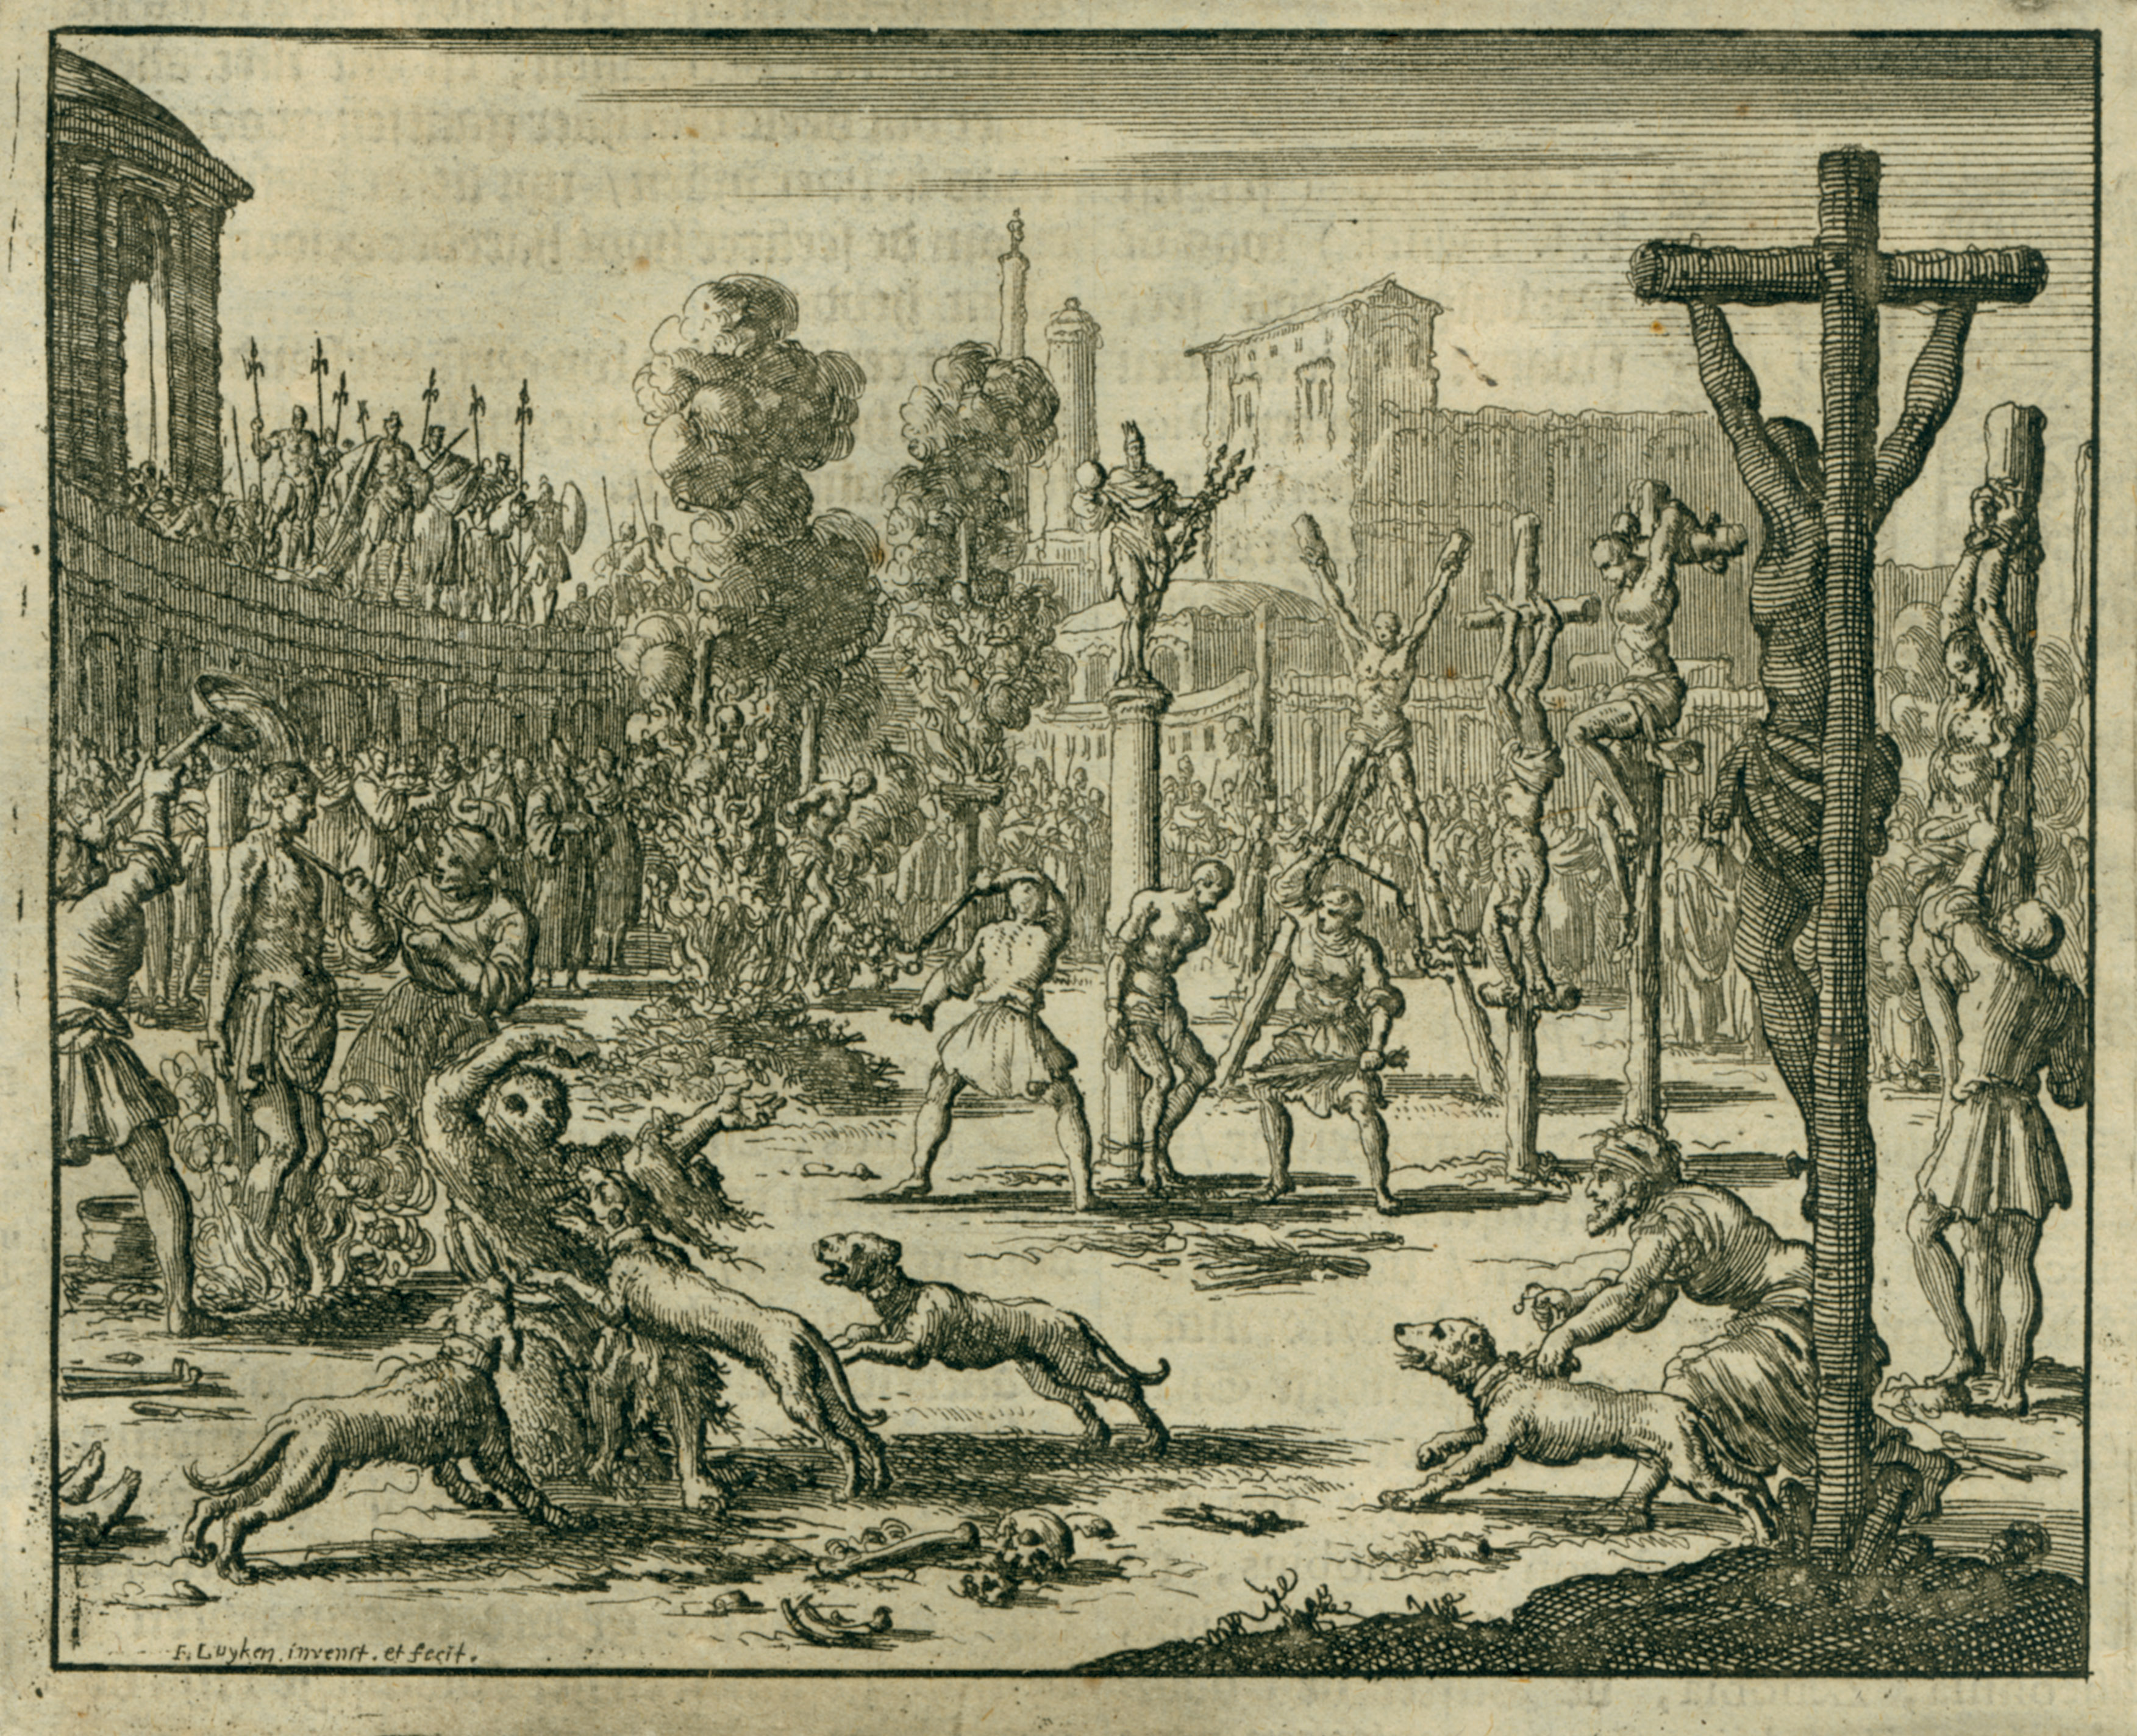

Slide 24
Constantine

Slide 25
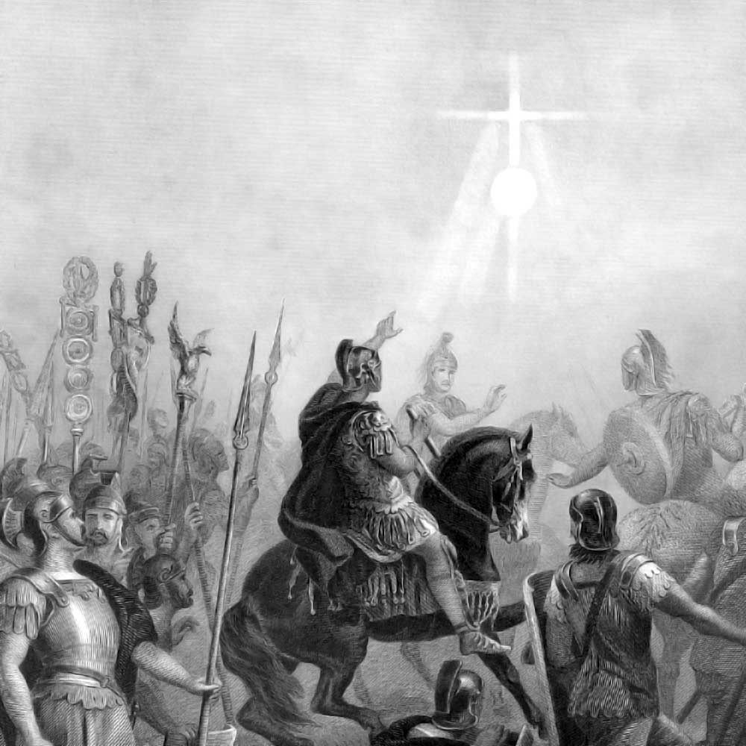

Slide 26
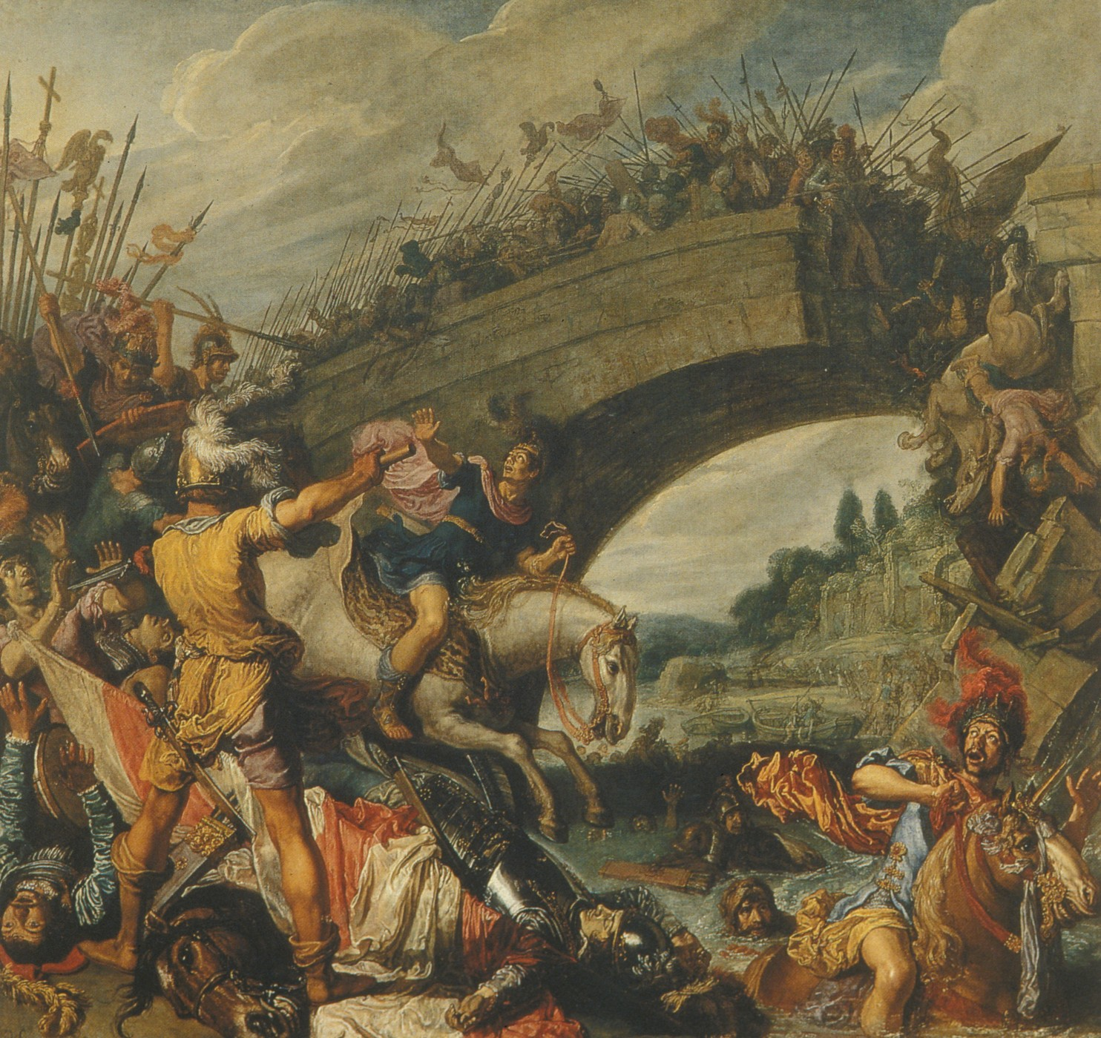

Slide 27
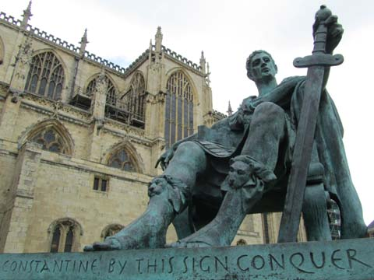

Slide 28
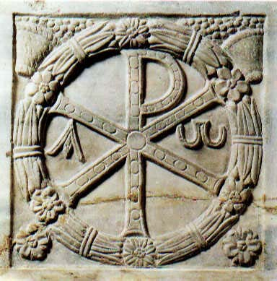

Slide 29
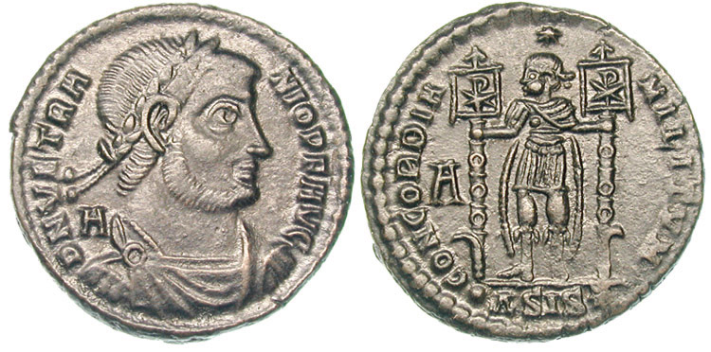
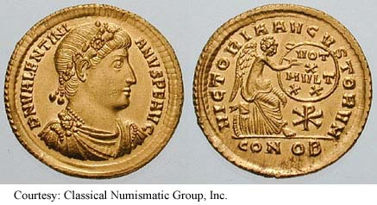

Slide 30
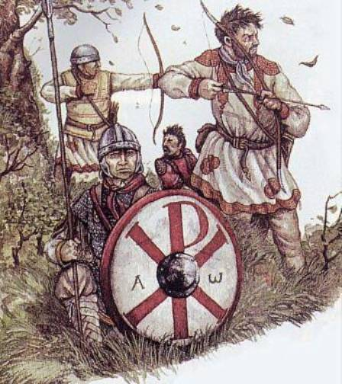

Slide 33
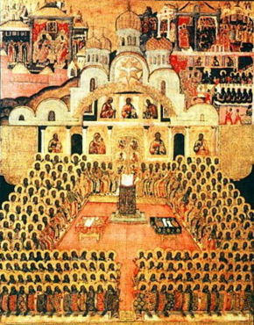
Christianity as Theology
Anathema to those who refuse to venerate with proper reverence the holy images of our Lord and His blessed saints.
Anathema to those who call the sacred images idols.
“Let them who do not venerate the holy and venerable images be Anathema! Anathema to those who blaspheme against the honorable and venerable images! To those who dare to attack and blaspheme the venerable images and call them idols, anathema! To the calumniators of Christianity, that is to say the Iconoclasts, anathema! To those who do not diligently teach all the Christ-loving people to venerate and salute the venerable and sacred and honourable images of all the Saints who pleased God in their several generations, anathema! To those who have a doubtful mind and do not confess with their whole hearts that they venerate the sacred images,
Anathema!”
(Second council of Nicea . A.D. 787)

Slide 34
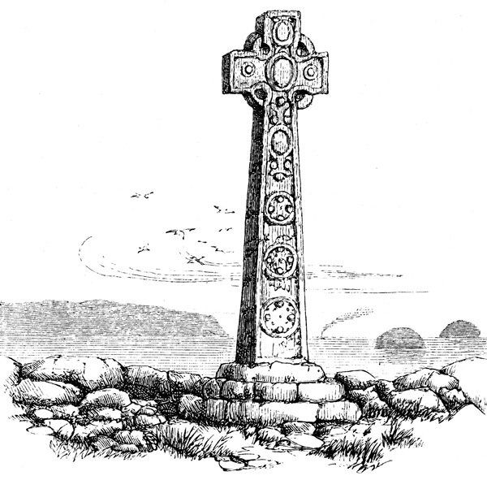
Who was St. Patrick?
He is believed to have died on March 17, around 460 A.D
Two authentic letters from him survive, from which come the only universally accepted details of his life. When he was very young, he was captured from Wales by Irish raiders and taken as a slave to Ireland, where he lived for six years before escaping and returning to his family. After entering the church, he returned to Ireland as an ordained bishop in the north and west of the island, but little is known about the places where he worked. By the seventh century, he had come to be revered as the patron saint of Ireland.

Slide 35
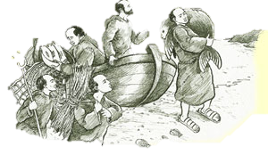
Columba`
Columba from the Isle of Iona.
The mission originated in 563 with the foundation of Iona by the Irish monk Saint Columba, and was initially concerned with ministering to the and converting the northern Picts kingdoms. Over the next centuries the mission grew in power and influence and spread through Anglo-Saxon England and the Frankish Empire.
The early mission is often associated with the Christian practice known as Celtic Christianity, which was distinguished by its organizations around monasteries rather than dioceses.

Slide 36
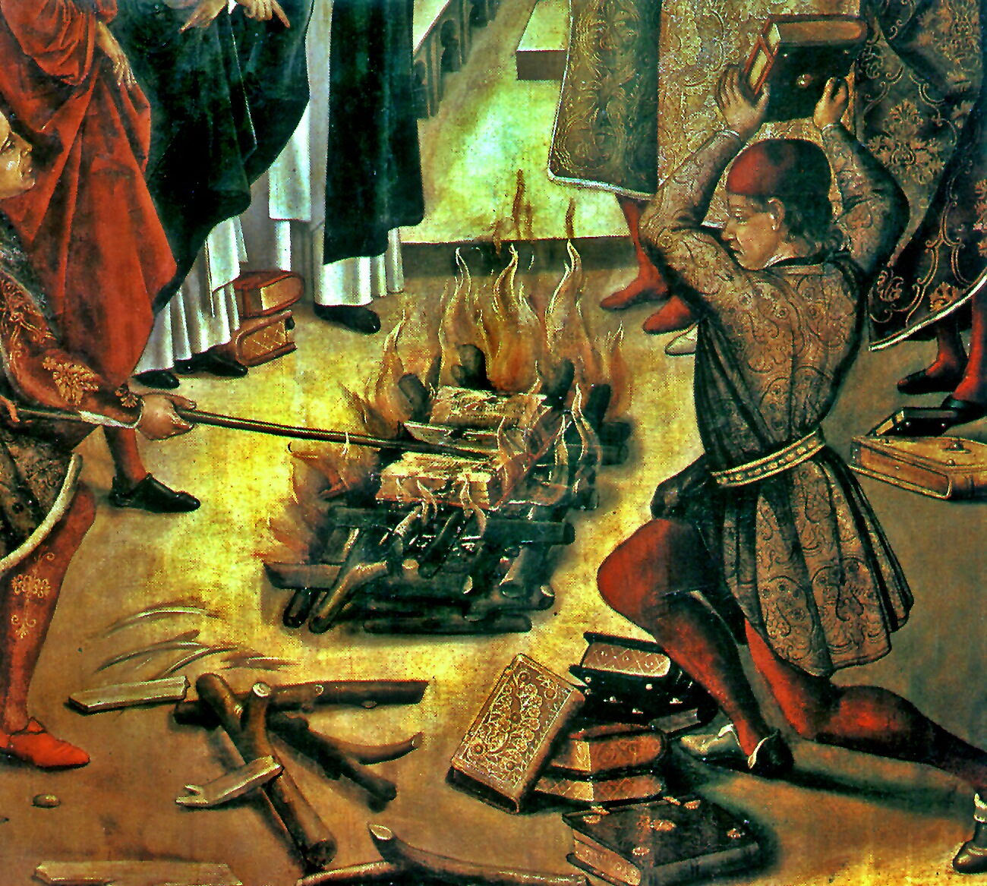
The Albigenses?
They began in the 12th century, and rejected the dominant Catholic church for its moral laxity: hence “Cathar”, meaning “clean. ” Catholics destroyed virtually every scrap the Cathars wrote, so we do not know their side of the story, but according to Catholic sources, Cathars believed the whole material world to be evil. Salvation lay in becoming one of the Perfect – However only the writings of the enemies remain.
Christian History Institute says that we should remember that at the Reformation, for example, both Protestants and Catholics lumped together good and bad Anabaptist groups and persecuted all of them without distinction. The historian cannot help but wonder whether good and bad Cathars were not similarly lumped together or even confused with Gnostic movements.
They lived very holy lives . Many of them practiced public preaching, did not swear oaths, lived modestly and many of them even lived in community. They tried to follow Jesus literally.

Slide 37
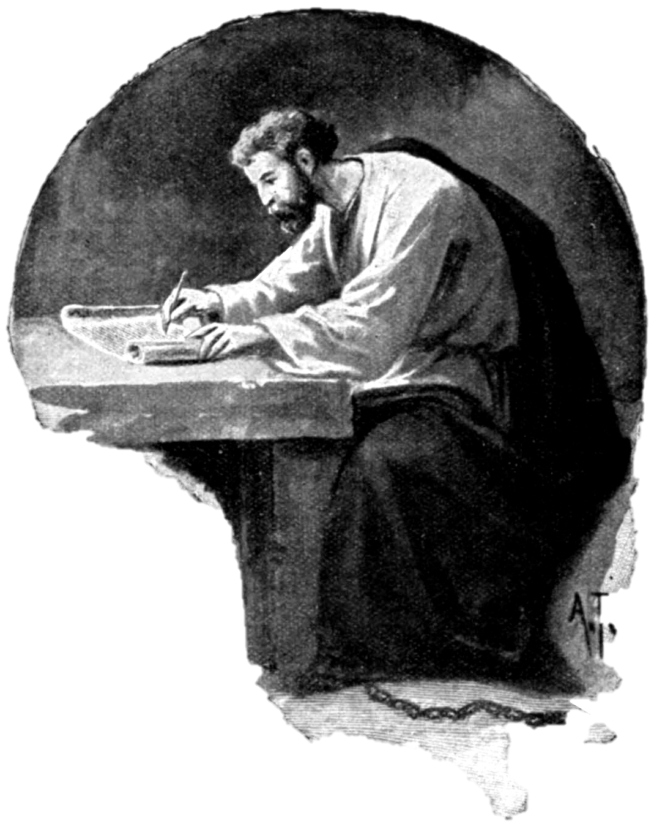
The Bogomils
“They bid those who listen to their doctrines to keep the commandments of the Gospel, and to be meek and merciful and of brotherly love. Thus they entice men on by teaching all good things and useful doctrines, but they poison by degrees and draw to perdition.” (quoted by Euthymius died 1118.)

Slide 38
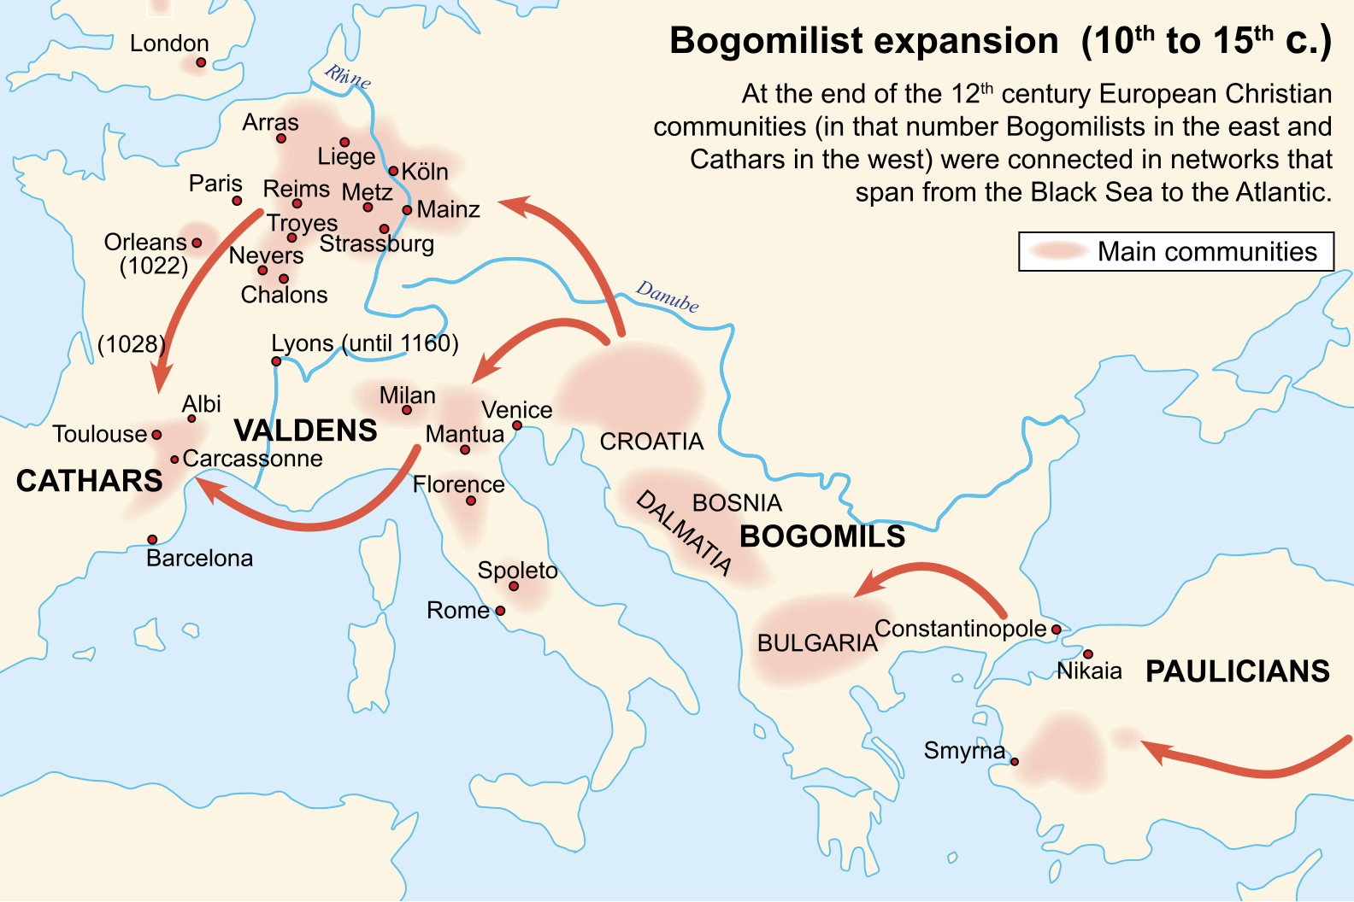

Slide 39
Peter Waldo ( 1140 – 1218)
Waldensians

Slide 40
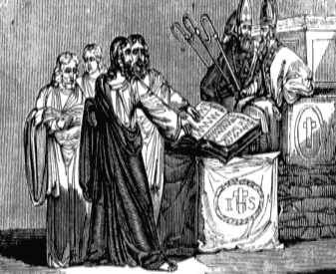
Conversion
In 1173 there lived at Lyons in France a certain citizen, Waldo by name, who had made much money by wickedly charging exorbitant interest rates…
Heard a troubadour playing a story of selling out to Christ and it griped his soul.
He eventually sold everything to pay back his bad dealings with the poor.

Slide 41
Two Masters!
“My fellow-citizens and friends, I not not insane, as you think, but I am avenging myself on my enemies, who made me a slave, so that I was always more careful of money than of God, and served the creature rather than the Creator. I know that many will blame me that I act thus openly. But I do it both for myself and for you; for myself, so that anyone who sees me from now on having any money may say that I am mad, and for you, that you may learn to put hope in God and not in riches.”

Slide 42
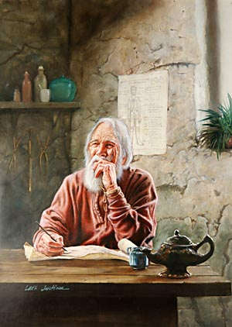
Waldo began to preach and teach in the streets. Followers gathered around him. These were known by many names, such as the Poor Men of Lyon, The Poor of God, Waldensians, or Waldenses. At some point Waldo commissioned a scholar to translate parts of the New Testament into Provençal, the local language. Lay preachers carried this word from place to place. Later, Waldensian peddlers also spread the gospel.

Slide 43
John Wycliff (1324-1384)
Lollard—babbler
His book—”The Kingdom of God” he said, “The Gospel of Jesus Christ is the only source of true religion.”
Scripture alone is truth!
Translated the scriptures into English.
“He put faith and sanctification together and does not see faith apart from works.” (Broadbent)
“Godly life was the evidence of salvation.”

Slide 44
The fire spreads
While all these rumblings jostled Bohemia, in England things were shaking a bit also. The Lollard movement was taking off, and John Wycliffe was preaching “strange” things at Oxford. He was bold enough to say that the Scriptures took precedence over tradition.
A young man from Prague named Jerome was in the audience. He became enthused with his teaching and carried it back to his homeland. Preaching that the Roman Church had apostatized, he caught the attention of John Huss, theological doctor and confessor to the Queen of Bohemia.

Slide 45
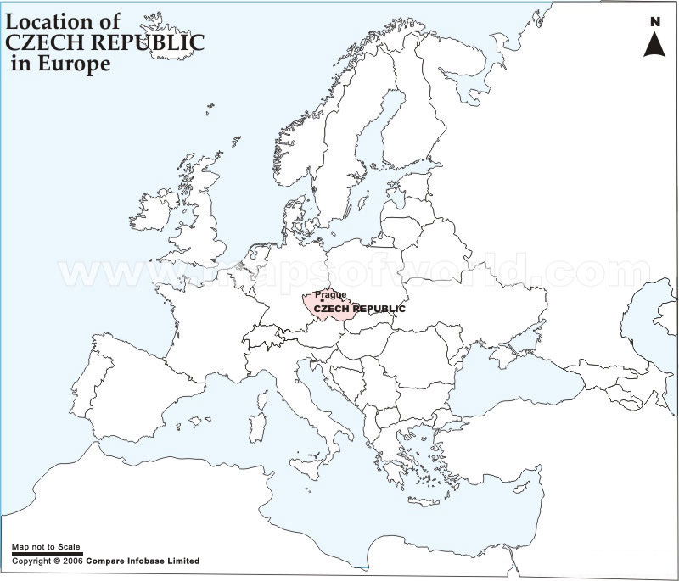

Slide 46
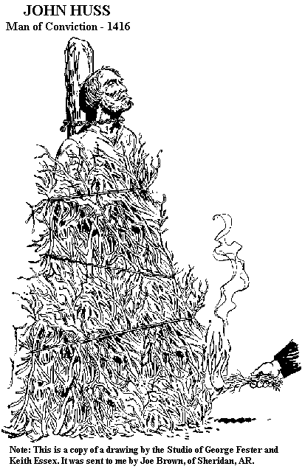
John Huss
John Huss eventually got in trouble with the Roman Catholics who had him burned at the stake.
Shortly before the flames were lit, John told them, “Today you roast a live goose”—the name Huss meant goose in Bohemian—“but within 100 years there will arise a swan that you will not be able to catch nor harm.

Slide 48
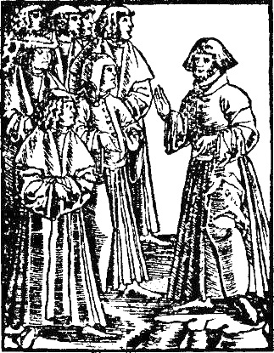
Peter Chelcicky

Slide 49
Czech Brethren
Peter Cheltschizki (Petr Chelčický) (ches ka-o)
Peter Chelcicky was present at the debate, and contended that for Christians, war was a crime. “What is war?” he asked. “It is a breach of the laws of God! All soldiers are violent men, murderers, a godless mob!” In 1420, Peter had traveled to Prague and listened to these men defend their views in the Bethlehem Chapel. What they said did not convince him. “You will not bring the kingdom of heaven to earth,” he told them, “as long as the hell of hatred burns in your hearts.”

Slide 50
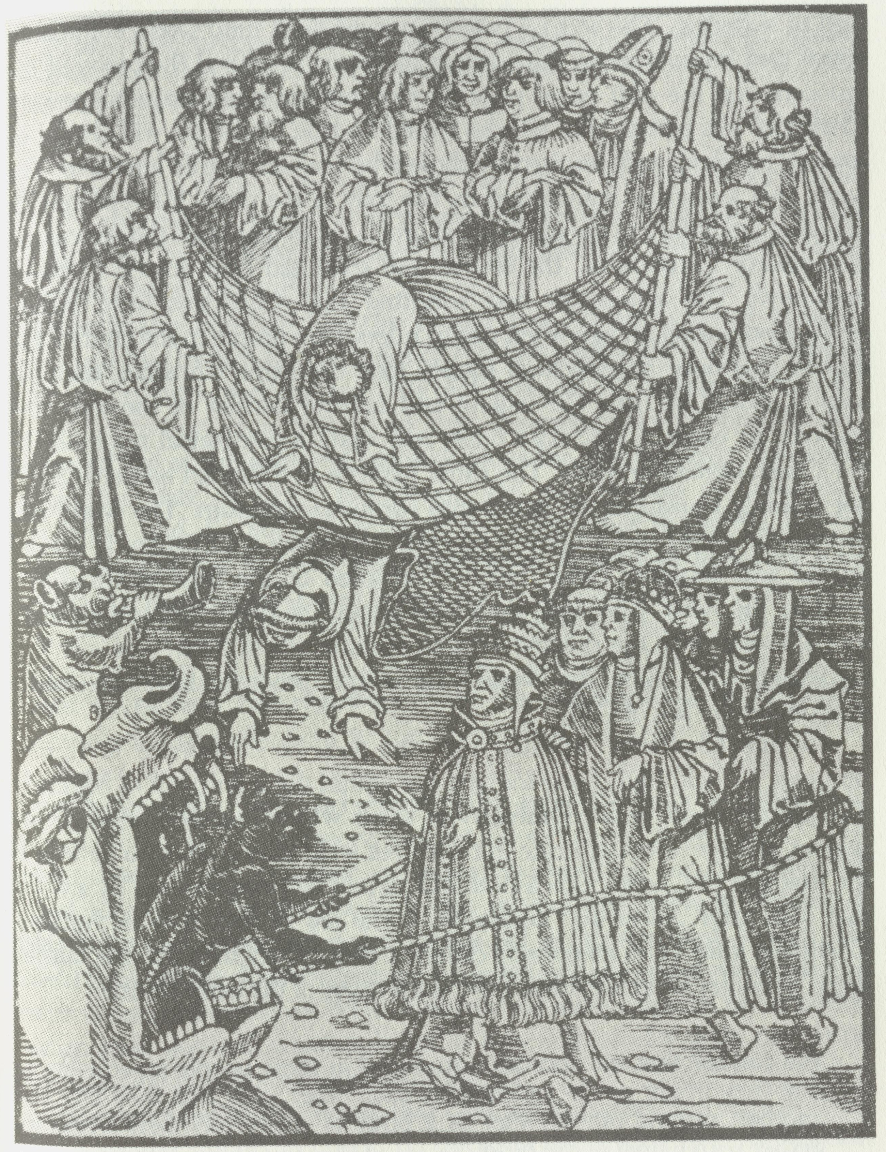
Net of Faith

Slide 51
The war of Babylon
You would not allow an individual to chase others and kill them. But if a nobleman gathers a great army of peasants and makes of them warriors who can kill others with the power of an army, you do not consider them murderers. Neither is it held against their conscience, but they boast and think of themselves as heroes for murdering the godless! This is the poison poured out among Christians by learned men who do not follow the meek Lord Jesus, but the counsel of the Great Whore of Babylon. And for this reason our land is filled with abominations and blood!

Slide 52
The wine of the great Whore
I do not want to make light of the preaching and good works done by men like John Huss, Matthias, and Jacob, in the name of God. But I say that they too have drunk the wine of the Great Whore, with which she has besotted all nations and people... They have written things that contradict God’s laws, especially where Master Huss has written about bearing the sword, swearing oaths, and venerating images. Therefore I cannot condone what they have passed on of an offensive nature to the scandalizing of many…

Slide 53
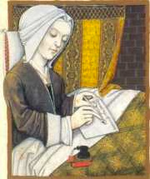
Beghards (also called Beguards) and Beguines (or Beguins) were Roman Catholic lay religious communities active in the 13th and 14th centuries, living in a loose semi-monastic community but without formal vows. They were influenced by Albigensian teachings and the Waldensians. The Beghards were the men, the Beguines the women of these free organizations.

Slide 54
Brethren of the Common Life
The Brethren of the Common Life was a religious brotherhood founded in Holland about the middle of the 14th century. Their purpose was to counteract the secularized life of the church by creating and promoting a truly pious Christian life shut away from worldly life, but actively engaged in earnest work for their fellow men, especially in education.
They lived in community houses, men and women in separate buildings. They were not bound by a vow; anyone could leave the community life at will. Obedience, celibacy, and poverty, the three fundamental monastic rules, were also practiced by them, but without a vow. Voluntary renunciation of private possessions and community of goods were based on the example of the early Christian church.
Erasmus studied here as a child.

Slide 55
ROGER BANNISTER
Roger Bannister

